Slide 1


wordpress
Matt Mullenweg & Mike Little.

Slide 2

WordPress (also known as WP or WordPress.org) is a web content management system. It was originally created as a tool to publish blogs but has evolved to support publishing other web content, including more traditional websites, mailing lists and Internet forum, media galleries, membership sites, learning management systems and online stores. Available as free and open-source software, WordPress is among the most popular content management systems – it was used by 42.8% of the top 10 million websites as of October 2021.
WordPress is written in PHP hypertext preprocessor language and paired with a MySQL or MariaDB database.

Slide 3

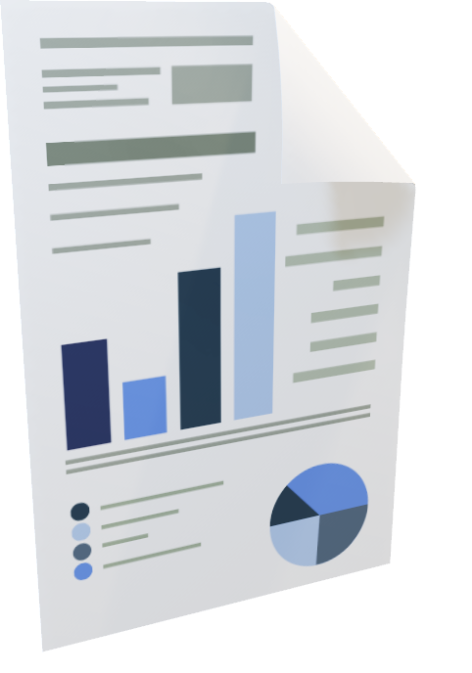
On 27 May 2003, WordPress got officially released by its founders, Matt Mullenweg and Mike Little. Before that, the b2/cafelog was widely used as a blogging tool that got launched in 2001 by French developer Michel Valdrighi. PHP, along with MySQL, was used for developing the b2. This tool was mainly meant for writing blogs.
It was the first version of WordPress, i.e., version 0.7, released on May 27, 2003. A subsequent version was released in January 2004, called the Davis version of WordPress. After few months of the release of WordPress, b2++ was developed by Donncha O Caoimh from Ireland and Francois planque from France. But, due to multiple forking
is done on b2, on 29th May 2003, Michel was sure to make WordPress the official division of b2.

Slide 4


Architecture
WORDPRESS WEBSITE ARCHITECTURE
When installing WordPress for the first time, a set of the CMS core folders and files are uploaded to the web server. The folder that hosts all these files is called public_html or the root directory
index.php:-
This PHP file is responsible for displaying your home page when users access your website. As the main template file in the template hierarchy, index.php is the fallback file that WordPress automatically loads when it cannot find the requested template file.
Functions.php:-
This is the template file to edit if you want to add your own custom features to the WordPress theme. The functions.php file is particularly useful for web developers and admins who want to expand the site’s functionality without installing a plugin.

Slide 5

Architecture
.htaccess
The .htaccess file is a configuration file for the Apache web server access control. It’s a critical WordPress core file that enables and disables the features of your website and certain plugins. You can also use it to manage redirects and permalinks.
WordPress automatically creates a .htaccess file on the root directory of websites hosted on an Apache web server.
wp-config.php
The wp-config.php file is responsible for establishing a connection between WordPress and the MySQL database. Without it, your website won’t be able to store and retrieve data from its database.
This configuration file stores all the data needed to access the site’s database, such as the database username, password, and host. WordPress stores it inside the root folder by default.

Slide 6


Component 1 – WP Core files
When you download WordPress from WordPress.org you get a zip file that contains the core foundational requirements needed for WordPress to work. In it you will find the PHP and related source files responsible for the basic functionality and appearance of your WordPress site.
Component 2 – wp-admin The Dashboard / UI
The admin interface is powered by this file. This file is what allows WordPress to be accessible to non-developers who want to build websites without having to learn code. wp-admin includes these components:
Dashboard,Posts,Media,Pages,Comments,Appearance,Plugins,Users,Tools,Settings.

Slide 7
Component 3 – Configuration files
wp-config.php
The wp-config.php tells WP how to connect to your database tables. This file contains MySQL settings, salts, unique and secret keys, the absolute path to the WP directory or ABSPATH, the database table prefix, debugging mode for developers and the WordPress database which contains these 12 tables:
wp_commentmeta
wp_comments
wp_links
wp_options

Slide 8
wp_postmeta
wp_posts
wp_termmeta
wp_terms
wp_term_relationships
wp_term_taxonomy
wp_usermeta
wp_users

Slide 9
Component 4 – You the user
The final component to how WordPress works is you. Users are required for the sites to go live, for the themes to be customized and for the appearance and for additional functionality to be added. The user is the force behind the content posted, the pages created and the site’s maintenance.
You are the final piece that makes each of the 60 million websites out there unique. Every day 100,000 WordPress are created from the combination of these 5 components but it’s this last component that is the most important to keeping WordPress sites safe.

Slide 10


License
The popular and widely used WordPress has been licensed under GPLv2, which is abbreviated as GNU General Public License (Richard Stallman designed GNU software), which makes it free of charge and is also open-source software. The predecessor blogging tool from where WordPress originated, i.e., b2/cafelog, was also licensed under GPLv2. Every copy of WordPress contains a license with it. Making WordPress license under GPL allows the freedom to install, modify, and distribute its source-code to others, also making it flexible enough to use.

Slide 11

6)USERS
There are five default user roles available in WordPress by default:
Administrator
On a regular WordPress website, the administrator role is the most powerful user role. Users with the administrator role can add new posts, edit posts by any users, and delete those posts.
Plus, they can install, edit, and delete plugins and themes.
Editor
Users with the editor role in WordPress have complete control over the content sections of your website.
They can add, edit, publish, and delete any posts on the site, including the ones written by others. An editor can moderate, edit, and delete comments as well.
Editors cannot change your site settings, install plugins and themes, or add new users.
Author
Users with the author role can write, edit, and publish their own posts. They can also delete their own posts, even if they are already published.

Slide 12

When writing posts, authors cannot create new categories, but they can choose from existing ones. They can also add tags to their posts.
Authors can view comments, even those that are pending review, but they cannot moderate, approve, or delete any comments.
Contributor
Users with the contributor role can add new posts and edit their own posts, but they cannot publish any posts.
When writing posts, they can choose from existing categories and create their own tags.
Contributors can also view all website comments, but they cannot approve or delete comments.
Subscriber
Users with the subscriber role can log in to your WordPress site, update their user profiles, and change their passwords.
They can’t write posts, view comments, or do anything else inside your WordPress admin area.
This user role is particularly useful if you have a membership site, online store, or another site where users can register and log in.

Slide 13


In 2022, people from at least 57 countries contributed to WordPress Core (56 countries in 2021).
Here is the top eight countries by number of contributors:
United States with 152 people (155 in 2021)
India with 77 people (58 in 2021)
Bangladesh with 43 people (only 13 in 2021)
United Kingdom with 38 people (34 in 2021)
Germany with 25 people (23 in 2021)
Netherlands with 23 people (20 in 2021)
France with 22 people (26 in 2021)
Canada with 17 people (16 in 2021)
Italy with 13 people (15 in 2021)
​

Slide 14


Growth of Headless WordPress
Headless WordPress refers to using WordPress as a backend CMS while using a different front-end technology to render the website. This approach offers better performance, security, and scalability. In the next five years, we can expect more developers to adopt headless WordPress, which offers greater flexibility in creating custom websites and applications.
Integration with Artificial Intelligence (AI)
Artificial Intelligence is already changing the way we interact with technology. In the future, WordPress is expected to integrate with AI to offer more innovative, more personalized experiences. AI-powered chatbots, automated content generation, and voice-activated search are just a few examples of how AI can enhance WordPress functionality.

Slide 15
Increased Focus on Accessibility
Web accessibility makes websites accessible to all users, including those with disabilities. As the importance of web accessibility continues to grow, we can expect WordPress to prioritize accessibility in its core development. This includes implementing accessibility standards, offering accessibility-focused themes and plugins, and providing better tools for developers to test accessibility compliance.
Emphasis on Security
As WordPress continues to grow, security threats will become more prevalent. As a result, in the next five years, we can expect WordPress to emphasize more security. This includes implementing more robust security measures in the core, offering better security-focused themes and plugins, and providing resources to educate users on best practices for implementing security.

Slide 16
1. WordPress is User Friendly
WordPress is a user-friendly platform that can be easily operated by anyone. It doesn't require any technical knowledge to handle it. It is an involuntary interface and a detailed setup makes it easy to create and manage websites. There are many simple features like drag-and-drop for editing.
2. Flexible and Customizable
WordPress offers a wide range of themes and plugins. You can use them to customize the look and functionality of the website. You can change it into a private blog, e-commerce store, business blog, or affiliate website.
3. Scalable and Adjustable
WordPress is a scalable platform that can handle websites of all sizes. You can make websites from small blogs to large e-commerce stores. This means that as your business grows, you can easily expand your website's functionality and capabilities.
4. Community Support
WordPress has a large and active community of users, developers, and contributors who are constantly working to improve the platform. You can take help at any time. They support in multiple languages and you can make sites in any language.

Slide 17
1. Security Risk
WordPress websites are widely used and have security threats, such as hacking, malware, and other attacks. To mitigate these risks, it is important to keep your WordPress site updated with the latest security patches and plugins. Unfortunately, if any cybercriminals attack and it can lead to loss of data, website downtime, and other serious issues.
2. Difficulty with Plugin
WordPress offers a lot of flexibility and customization options. This can also make it more complex and difficult to use, especially for using plugins. Additionally, with so many options available, it can be challenging to determine the best way to set up and configure. When we install too many plugins then it affects the speed of the website.
3. Performance and Speed
WordPress sites can be slower to load than some other types of websites. It will happen if you are using a lot of plugins or customizations. This can directly impact user experience and SEO, as slower sites are penalized in search engine rankings. Speed is the direct ranking factor of SEO and user experience.
4. Maintenance and Updates
WordPress requires regular updates and maintenance to ensure that it stays secure and runs smoothly. This can be time-consuming and challenging for those who are not familiar with web development or hosting. The updates come on a regular basis and it will be challenging for newbies to manage it.

Slide 18

Seek First to Find Balance
spending too much time on one area of your life is a quick way to throw things out of balance. Not eating properly, not exercising and not spending time with friends or family is not a path to greater productivity. It might be for a short period of time, but then it’ll catch up to you, and I guarantee the first thing to suffer will be that which you are trying to improve. One of the best things you can do for yourself is to map out the parts of your life that you value the most. Then, decide how much time you want to reasonably spend on each one.
Consider mapping out the following areas of your life:
Work
Health and fitness
Friends
Family
Time with kids
Your hobbies
Sleep
Consider Your Work Environment
Your work environment has a tremendous effect on productivity. Look around you. Is your desk clean and organized ? Keeping yourself surrounded by a blank slate keeps your mind creative, less distracted and stress-free.
Prioritize and Focus

Slide 19
a) what is wordpress:- Wikipedia (https://en.wikipedia.org/wiki/WordPress)
b) History:- w3schools.in (https://www.w3schools.in/wordpress/wordpress-history)
c) Architecture:- Hostinger(https://www.hostinger.in/tutorials/wordpress-architecture)
d) Components:-(https://origin-blog.mediatemple.net/web-development-tech/5-elements-wordpress/)
e) Licensing:- Wordpress(https://wordpress.org/about/license/)
f) Users:- WPbeginner(https://www.wpbeginner.com/beginners-guide/wordpress-user-roles-and-permissions/)
g) Major contribution taken place:- Wordpress(https://make.wordpress.org/core/2023/01/03/a-year-in-core-2022/)
h) Future enhancement:- Linkedin(https://www.linkedin.com/pulse/future-wordpress-what-expect-next-five-years-sarath-kumar-kalamata#:~:text=Integration%20with%20Artificial%20Intelligence%20(AI)&text=In%20the%20future%2C%20WordPress%20is,AI%20can%20enhance%20WordPress%20functionality.)
i) Advantages & disadvantages:- dgaps.com(https://dgaps.com/advantages-disadvantages-of-wordpress-518)
j) Working environment:- Elegant Themes(https://www.elegantthemes.com/blog/resources/wordpress-developers-how-to-create-a-productive-working-environment)

Slide 20
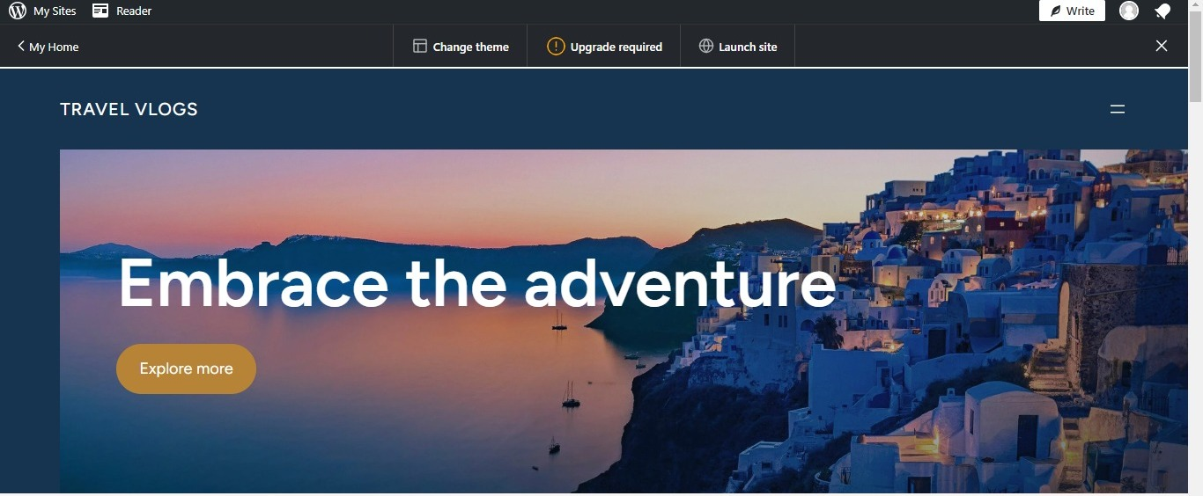
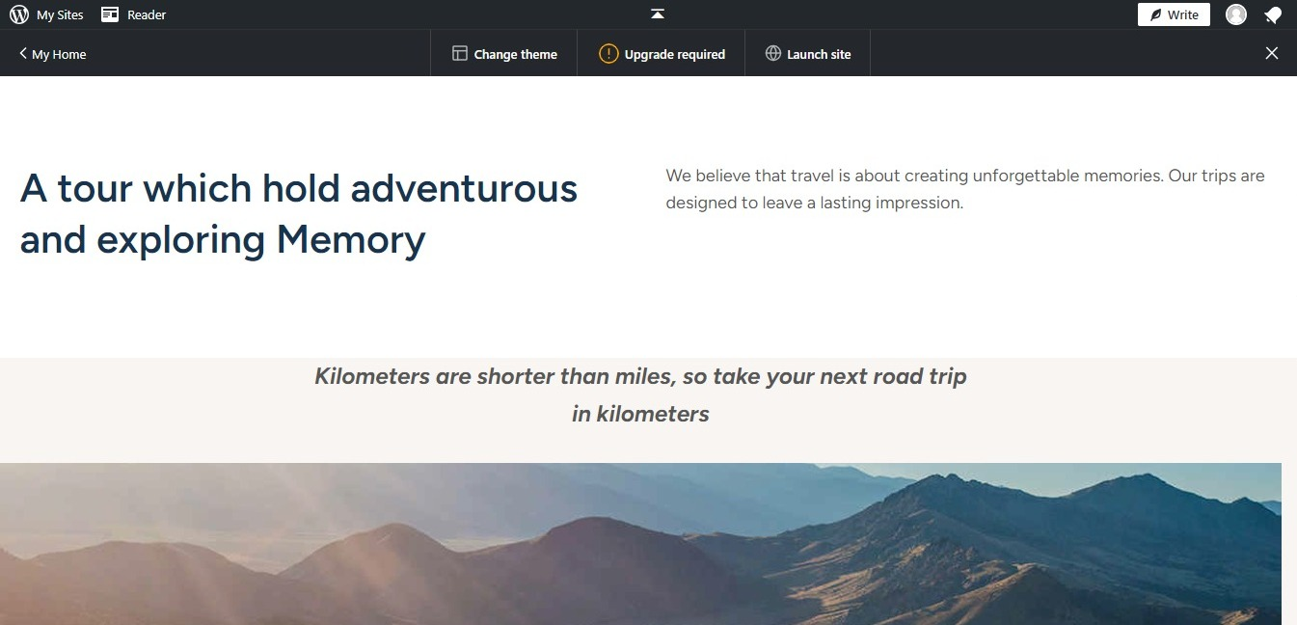
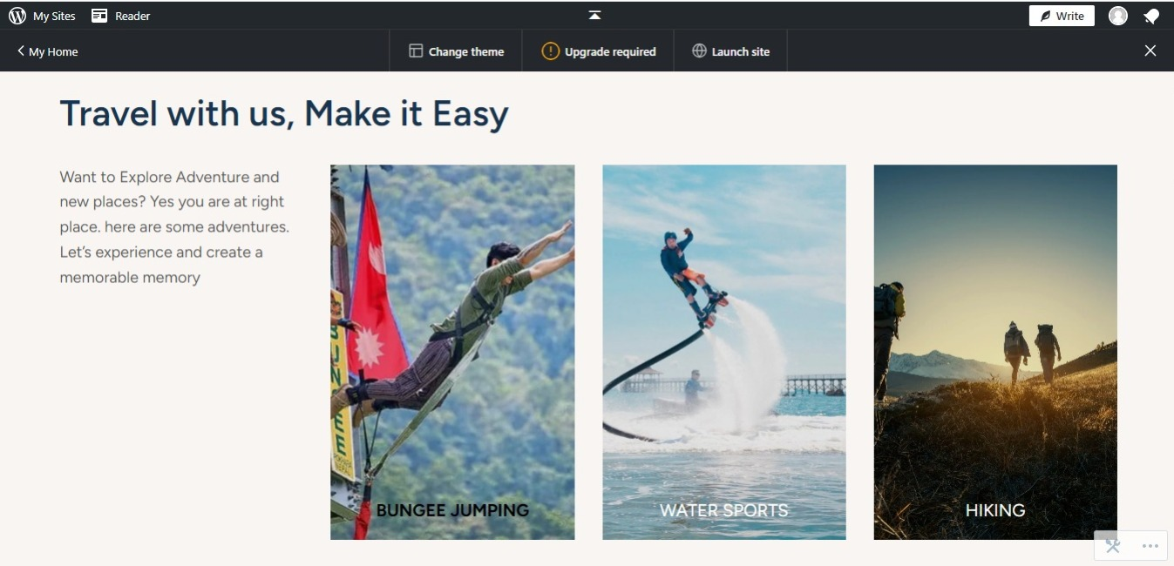
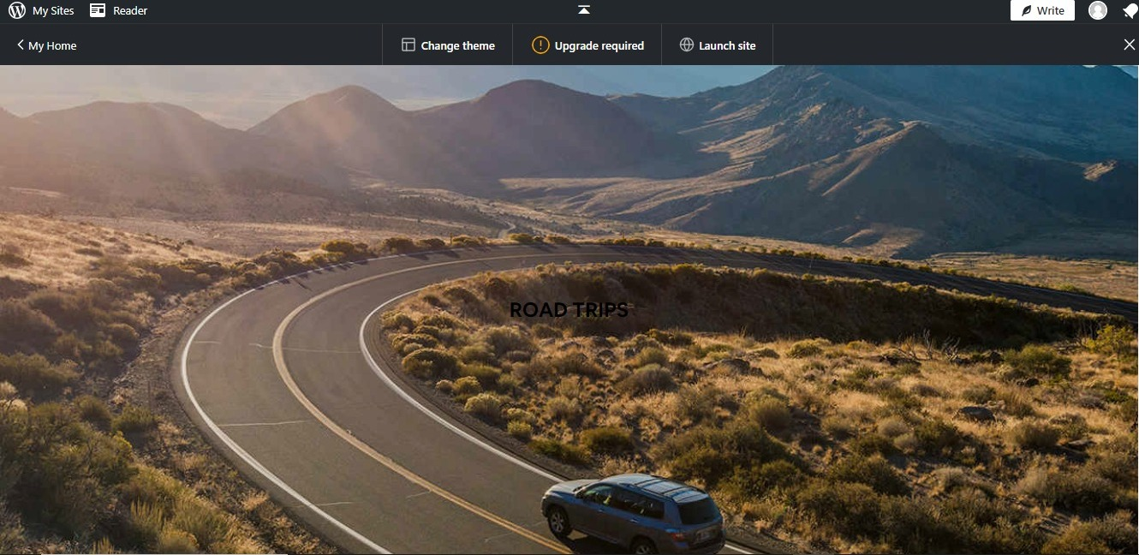
IMPLEMENTATION

Slide 21
